Slide 1

Source

Slide 2
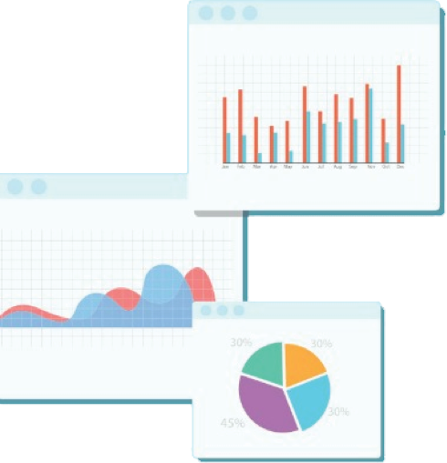

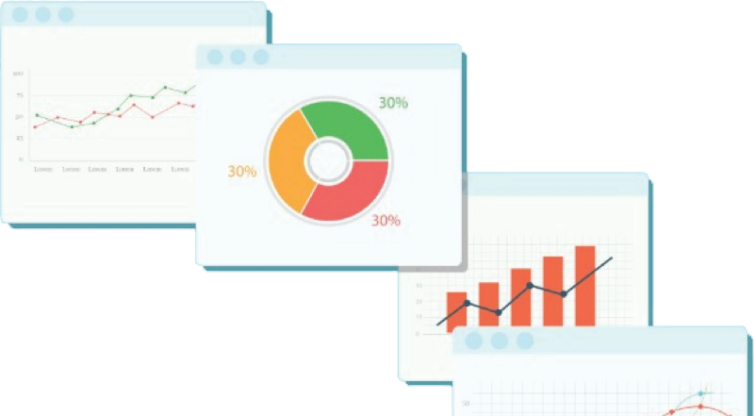
Welcome to Week 1
Lecture 2!
Data Science in Python &
Machine Learning

Slide 3
Learning Goals:
At the end of this lesson you will be able to:
Distinguish ‘Practice’ assignments from ‘Core’ assignments.
Review feedback, including assignment status:
Passed, Missing, Resubmit
Codealong Introduction to Packages & Numpy
Load data into a Pandas dataframe from a .csv or .xlsx file
Read error messages to debug code.

Slide 4
Announcements &
Reminders

Slide 5
Bonus (Optional)
Lesson/Codealong on Python Basics
When?
Tomorrow, 01/28/22 at 5 PM PST (normal lecture time)
What?
We will walk through the solution this week’s Code Review Activity on Python Basics:
Repo link: https://github.com/sensei-jirving/code-reviews-week-1-python-basics
Why?
Because this will be our final session focusing on JUST basic python.
You do not need to have completed the activity to attend.
Will it be recorded?
Yes!
Is attendance required?
Absolutely not!
But strongly recommended.

Slide 6
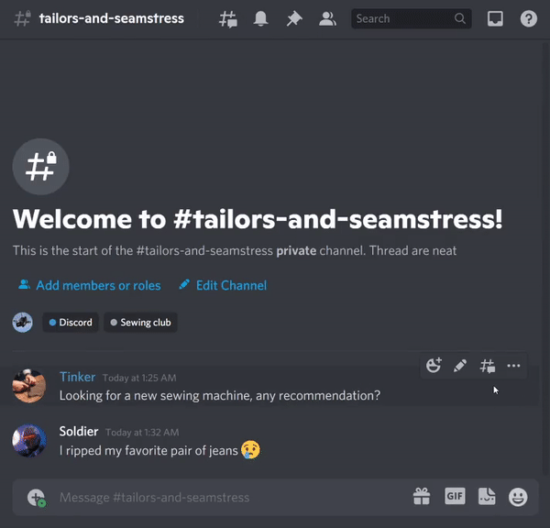
Please Use Discord Threads Insteads of Replies
Discord has 2 ways to respond to a message:
❌Reply: appears on main channel, disconnected from original message.
✅Create a thread: creates a sidebar conversation that keeps every response grouped together and accessible.
Why?
Easier for others to benefit from your questions and answers.
Reduces clutter & intimidation

Slide 7
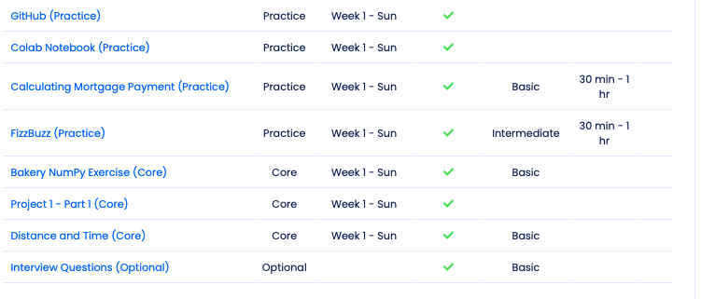
Core Assignments are due Sundays
Always double check you feedback document for which assignments are Core

Slide 8
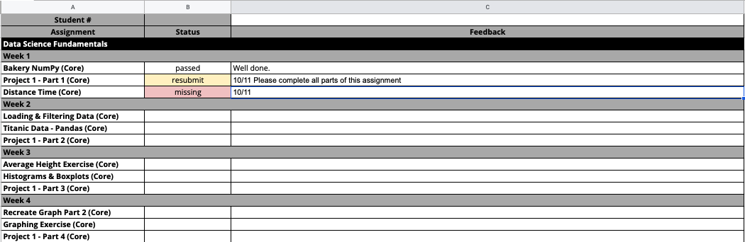
Your Personal Feedback Document
A Google Sheet like this has been shared with you!
Please verify that your name is at the top of this document
This is where you will see if you have passed or if your task needs to be resubmitted
Grading occurs on Monday and Tuesday. This is a live document so check back for updates!
Assignments marked ‘resubmit’ count as submitted for the week they are due, BUT must be corrected and resubmitted by the following Sunday or they will be retroactively considered ‘missing’ for the purpose of calculating Academy Probation.

Slide 9
Week 1 CORE Assignments
These MUST be submitted by 12:59 pm PST on Sunday January 30th:
Bakery NumPy Exercise
Project 1 - Part 1
Distance and Time
If a core assignment is missing, you will be placed on academic probation
even if you have done other assignments and
even if you have spent a lot of time learning and working
Note: If you accumulate 3 academic probations at any time during the program, you will be recommended for dismissal. Probations are cumulative and irreversible except in the case of documented mitigating circumstances.

Slide 10
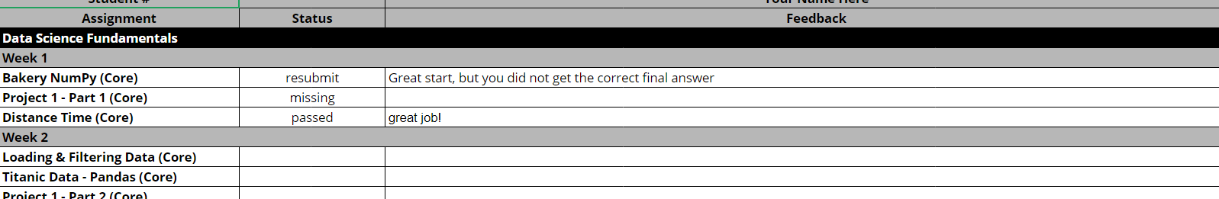
Sample Feedback:
**Typically updated by Wednesday morning**
The ONLY way you will know you have a resubmit is opening this document!
Note that if the status box is empty, the assignment has not been reviewed yet.
If the status is “passed” and the feedback box is empty, no news is good news!

Slide 11

Resubmission
You will be asked to resubmit a task if:
There are errors in your code
Parts of the assignment are missing
Parts of the assignment are incorrect
The file or link cannot be opened
The work is low quality and/or difficult to read and follow
Please don’t stress if you are asked to resubmit an assignment! It just means that there is room for improvement, and we want to ensure you’ve demonstrated competency and professionalism in each task.
You can resubmit on the Learn Platform in the same place that you submitted your original assignment.
Resubmitted assignments will automatically be checked along with the next week’s assignments.
All assignments marked ‘resubmit’ must be corrected and resubmitted before the end of the stack in order to move forward.

Slide 12

Python Packages/Modules
Python comes with many built-in functions [Built-In Functions]
print, type, range, etc
But most of the functionality we need as data scientists is not included in base Python.
We can download other collections of functions and classes, called Packages (A.K.A. Libraries A.K.A Modules)
Packages You will Be Using in Stack 1:
Numpy
Pandas
Matplotlib
Seaborn

Slide 13
Intro to Packages with NumPy
Hop over to our Colab Notebook:
📓 Intro to Python Packages - NumPy

Slide 14

Loading and Exploring Data
with Pandas 🐼!

Slide 15
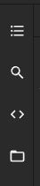
Getting Data into Colab
Two Options:
Save file in Drive
Mount drive
Open file folder in Colab on the left:
Navigate to file in Drive
Right click file and ‘copy filepath’
Download data locally and upload to temporary Colab environment
Download data
Open file folder on the left
Drag and drop the file from your computer to upload it
Right click file and ‘copy filepath’

Slide 16
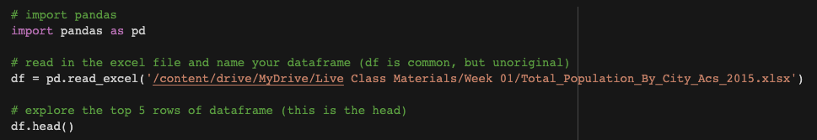
pd.read_csv() and pd.read_excel()
Different file types need different functions to load them:
.csv files → pd.read_csv(‘filepath’)
.xlsx files → pd.read_excel(‘filepath’)
‘filepath’ can be a remote URL as long as it points directly to a .csv or .xlsx file.
Other functions exist to load other file types, but these are the ones we will use.

Slide 17
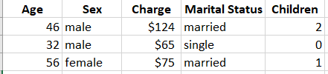
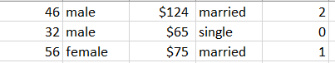
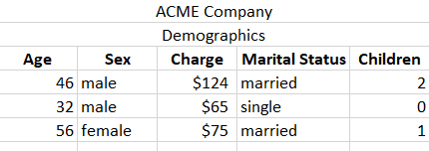
Headers
Header is top row. (This is default assumption)
pd.read_excel(‘path’)
pd.read_excel(‘path’, header = 0)
No header
pd.read_excel(‘path’, header = None)
Header present, but not at the top
pd.read_excel(‘path’, header = 2)

Slide 18
Quick Look at top and bottom of dataframe
This will give you the top 5 rows: df.head()
To see a different number of rows such as the first 8 rows: df.head(8)
To see the bottom 5 rows df.tail()
To see a different number of rows such as the last 11 rows df.tail(11)
To see random rows df.sample(5)

Slide 19
Checking data types
To get lots of info including data type, index, df.info()
and Column Names
To get JUST the data type for all columns: df.dtypes
To get the data type for just one column df[‘name’].dtypes

Slide 20
Slicing Dataframes:
Selecting specific column(s)
To select 1 column as a pandas series df[‘name’]
To select 1 column as a pandas dataframe df[[‘name’]]
To select multiple columns as a dataframe df[[‘name’, ‘Manufacturer’]]
Notice double square brackets for dataframe

Slide 21
How many rows and columns?
To get lots of info including data type, index, df.info()
and Column Names
To get the shape (rows, columns) df.shape
To get the number of rows len(df)
To get the number of columns len(df.columns)

Slide 22
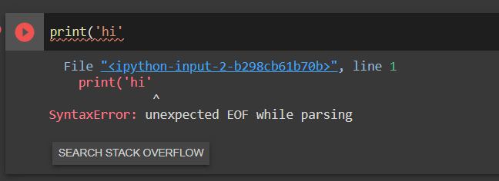
A Note About Errors:

Slide 23
Listen to your error messages!
The most helpful information about the error is usually at the BOTTOM of the error message.
Sometimes you have to scroll down to find it.
EOF (End of File) error usually indicates you that you don’t have complete (open and closed)
( )
[ ]
{}

Slide 24
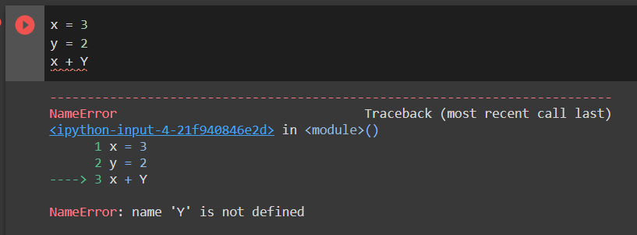
Listen to your error messages!
This NameError tells you that you have not defined a value for Y
Note that lowercase was used to define y = 2, but variables are case sensitive!

Slide 25
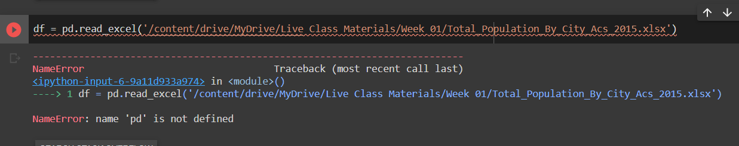
Listen to your error messages!
This says that pd is not defined which means I must not have imported the pandas library
or
maybe I did not assign it an alias (pd)
or
maybe I had a typo in the alias.
Either way, it means check that code!

Slide 26
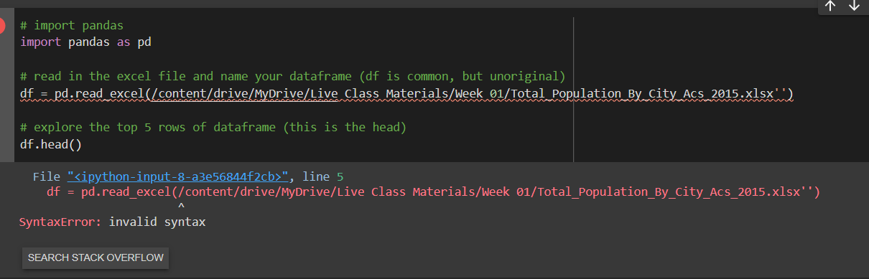
SyntaxError means you made a typo in the code.
Here both quotes are at the end instead of one at the beginning.
A variety of typos give syntax errors such as misspelling a keyword like ‘pritn’ instead of ‘print’
Explore this link for more help in understanding your SyntaxErrors

Slide 27
Loading & Exploring a Data Set
Data
Data Set: Total Population by City
Today’s Colab Notebook
Data Set Source

Slide 28

We learn through failure & trial/error.

Slide 29
Questions?

Slide 30
Today’s Notebooks
📓 Intro to Python Packages - NumPy
⛳️ Loading & Exploring Data - Group Activity

